Slide 1
DATA MODELS, SCHEMAS, AND INSTANCES
Lecture TWO

Slide 2
DATABASE SCHEMA
When the database is designed to meet the information needs of an organization, the schema of the database and the actual data to be stored in it becomes the most important concern of the organization. It is important to note that the data in the database changes frequently, while the schema remains the same over periods of time (although not necessarily forever).
The description of the database is known as schema. It gives the names of the entities and attributes. It specifies the relationship among them. It is a framework into which values of the data fields are fitted.
The data values that populates the database at any point in time is known as an instance of the database. It is also referred to as the state of the database or snapshot

Slide 3
THREE LEVEL ANSI-SPARC DATABASE ARCHITECTURE
A database system is a collection of interrelated data and a set of programs that allow users to access and modify these data. A major purpose of a database system is to provide users with an abstract view of the data. That is, the system hides certain details of how the data are stored and maintained (data abstraction).
For the system to be usable, it must retrieve data efficiently. The need for efficiency has led designers to use complex data structures to represent data in the database. Since many database-system users are not computer trained, developers hide the complexity from users through several levels of abstraction, to simplify users’ interactions with the system.

Slide 4
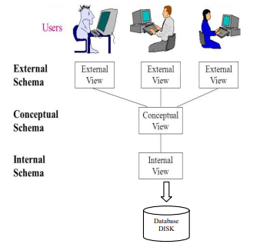
Three level database architecture
The architecture consists of the following levels
  1. External level
  2. Conceptual level
  3. Internal level

Slide 5
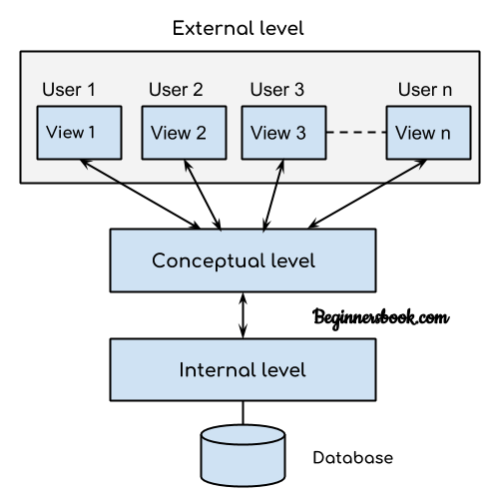
THREE-SCHEMA ARCHITECTURE
1. External level
The external level is the user’s view of the database. This level is at the highest level of abstraction where only those portions of the database of concern to a user or application program are included.
In other words, this level describes part of the database that is relevant to the user. Any number of user views, even identical, may exist for a given conceptual or global view of the database. This external view includes only those

Slide 6
THREE-SCHEMA ARCHITECTURE
2. Conceptual level
It is also known as the logical level. At this level of database abstraction, all the database entities and relationships among them are included. This level describes what data is stored in the database and the relationships among the data. It contains the logical structure of the database as seen by the database Administrator.
The conceptual schema hides the details of physical storage structures and concentrates on describing entities, data types, relationships, user operations, and constraints.
The conceptual level supports each external view, in that data available to a user must be contained in or derived from, the conceptual level.

Slide 7
THREE-SCHEMA ARCHITECTURE
3. Internal level
It is the physical representation of the database on the computer and this view is found at the lowest level of abstraction. This level indicates how the data will be stored in the database and describes the data structures, file structures and access methods to be used by the database.
Essentially, internal schema summarizes how the relations described in the conceptual schema are actually stored on secondary storages devices such as disks and tapes..

Slide 8
Advantages of Three level architecture
The main objective of this architecture is to isolate each user’s view of the database from the way the database is physically stored or represented. Following are the advantages of the architecture
Each user is able to access the same data but have different customized view of the data as per their own needs. Each user can change the way he or she views the data and this change does not affect other users of the same database.
The user is not concerned about the physical data storage details. The user’s interaction with the database is independent of physical data storage organization.
The internal structure of the database is unaffected by changes to the physical storage organization, such as changeover to a new storage device.
The database administrator is able to change the database storage structures without affecting the user’s view
The database administrator is able to change the conceptual structure of the database without affecting all users.

Slide 9
DATA INDEPENDENCE
Data independence is a major objective of implementing DBMS in an organization. It is the capacity to change the schema at one level of a database system without having to change the schema at the next higher level.
Data independence is achieved by DBMS through the three-schema architecture of data abstraction
There are two types of data independence:
  Logical data independence
  Physical data independence

Slide 10
DATA INDEPENDENCE
Logical data independence is the capacity to change the conceptual schema without having to change external schemas or application programs. We may change the conceptual schema to expand the database (by adding a record type or data item), to change constraints, or to reduce the database (by removing a record type or data item)
Physical data independence is the capacity to change the internal schema without having to change the conceptual schema. Hence, the external schemas need not be changed as well.

Slide 11
DATA MODELS
One fundamental characteristic of the database approach is that it provides some level of data abstraction by hiding details of data storage that are not needed by most database users.
A data model is a collection of concepts that can be used to describe the structure of a database and it provides the necessary means to achieve this abstraction.
By structure of a database, we mean the data types, relationships, and constraints that should hold for the data. Most data models also include a set of basic operations for specifying retrievals and updates on the database.

Slide 12
TYPES OF DATA MODELS
The categories of data models include
  Object Oriented model
  Entity Relationship model (ER Model)
  Relational model
  Network model
  Hierarchical model

Slide 13
TYPES OF DATA MODELS
E-R Model ( Entity Relationship Model)
Entity-Relationship (ER) Model is based on the notion of real-world entities and relationships among them.
While formulating real-world scenario into the database model, the ER Model creates entity set, relationship set, general attributes and constraints.
Object-Oriented Model
In Object-oriented Model data stored in the form of objects. It defines a database as a collection of objects which stores both data member values and operations.

Slide 14
TYPES OF DATA MODELS
Relational Model
In relational model, the data and relationships are represented by collection of inter-related tables.
Each table is a group of column and rows, where column represents attribute of an entity and rows represents records
Hierarchical Model
Data is organized into a tree like structure with each record having one parent record and many children.
The main drawback of this model is that, it can have only one to many relationships between nodes.
Network Model – Network Model is same as hierarchical model except that it has graph-like structure rather than a tree-based structure. Unlike hierarchical model, this model allows each record to have more than one parent record.

Slide 15
Data Modeling Using the Entity-Relationship Model
  Conceptual modeling is a very important phase in designing a successful database application.
  The Entity-Relationship (ER) model, which is a popular high level conceptual data model, concentrates on the database structures and constraints during database design.
  This model and its variations are frequently used for the conceptual design of database applications, and many database design tools employ its concepts.
  The ER model describes data as entities, relationships, and attributes

Slide 16
Entities and Attributes
  The basic object that the ER model represents is an entity, which is a "thing" in the real world with an independent existence.
  An entity may be an object with a physical existence (for example, a particular person, car, house, or employee) or it may be an object with a conceptual existence (for example, a company, a job, or a university course).

Slide 17
Entities and Attributes
  Each entity has attributes-the particular properties that describe it.
  For example, an employee entity may be described by the employee's name, age, address, salary, and job.
  A particular entity will have a value for each of its attributes. The attribute values that describe each entity become a major part of the data stored in the database.

Slide 18
TYPES OF ATTRIBUTES
  There are several types of attributes in a ER model:
      Simple attribute
      Composite attribute
      Single-valued attribute
      Multivalued attribute
      Derived attribute

Slide 19
Types of attributes
Simple attribute − Simple attributes are atomic values, which cannot be divided further. For example, a student's phone number is an atomic value of 10 digits.
They are represented by use of an eclipse as shown below.
name
Birthdate
Stud_RegNo
Student

Slide 20
Types of attributes
Composite attribute
Composite attributes are made of more than one simple attribute.
For example
A student's full name may have first_name and last_name.
The Address attribute of an employee can be subdivided into StreetAddress, City, State, and Zip,
If the attributes are composite, they are further divided in a tree like structure. Every node is then connected to its attribute.
First_name
Last_name
name
Student

Slide 21
Types of attributes
Multi-value attribute − Multi-value attributes may contain more than one values. For example, a person can have more than one phone number, email_address, etc. Multivalued attributes are depicted by double ellipse.
Student
Phone number

Slide 22
Types of attributes
Derived attribute − Derived attributes are the attributes that do not exist in the physical database, but their values are derived from other attributes present in the database. For example, average_salary in a department should not be saved directly in the database, instead it can be derived. For another example, age can be derived from date_of_birth.
They are represented by use of dashed eclipse
Birthdate
Student
Age

Slide 23
Types of attributes
Single-value attribute − Single-value attributes contain single value. For example − Social_Security_Number, registration number, National ID number etc.
It is depicted just like a simple attribute.

Slide 24
Relationship between entities
The association among entities is called a relationship. For example, an employee works_at a student department, a student enrolls in a course. Here, Works_at and Enrolls are called relationships.
The degree of a relationship type is the number of participating entity types. Hence, the WORKS FOR relationship is of degree two.
A set of relationships of similar type is called a relationship set.
Like entities, a relationship can have attributes. These attributes are known as descriptive attributes.

Slide 25
Relationship between entities
Relationships are represented by a diamond-shaped box.
Name of the relationship is written inside the diamond-box. All the entities (rectangles) participating in a relationship, are connected to it by a line as shown below
Works_at
Employee
University

Slide 26
Constraints on Relationships
Relationship usually have certain constraints that limit the possible combinations of entities that may participate in the corresponding relationship set.
For example, if a company has a rule that each employee must work for exactly one department, then we would like to describe this constraint in the schema.
We can distinguish two main types of relationship constraints:
  Cardinality ratio
  Participation

Slide 27
Participation Constraints
The participation constraint specifies whether the existence of an entity depends on it being related to another entity via the relationship type.
There are two types of participation constraints: total (existence dependency) and partial which we illustrate by example.
If a company policy states that every employee must work for a department, then an employee entity can exist only if it participates in at least one WORKS_ FOR relationship instance.
Thus, the participation of EMPLOYEE in WORKS_FOR is called total participation, meaning that every entity in "the total set" of employee entities must be related to a department entity via WORKS_FOR.

Slide 28
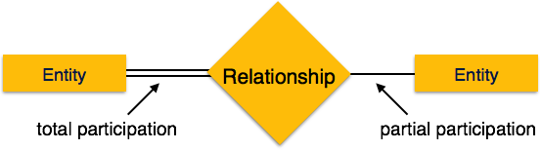
Participation Constraints
If each department of an organization is managed by an employee, we do not expect every employee to manage the department, so the participation of EMPLOYEE in the MANAGES relationship type is partial, meaning that some or "part of the set of" employee entities are related to some department entity via MANAGES, but not necessarily all.
ER diagrams, total participation (or existence dependency) is displayed as a double line connecting the participating entity type to the relationship, whereas partial participation is represented by a single line

Slide 29
Cardinality Ratio
The cardinality ratio for a binary relationship specifies the maximum number of relationship instances that an entity can participate in.
For example, in the WORKS_FOR binary relationship type, DEPARTMENT: EMPLOYEE is of cardinality ratio l:N, meaning that each department can be related to (that is, employs) any number of employees, but an employee can be related to (work for) only one department.

Slide 30
Cardinality Ratio
The possible cardinality ratios for binary relationship types are
    One to one (1:1)
    One to many (l:N)
    Many to one (N:l)
    Many to many (M:N)

Slide 31
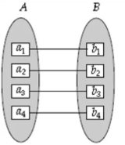
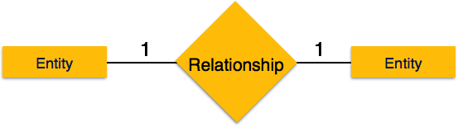
Cardinality of relationships
One-to-one − An entity A is associated with at most one entity in B, and an entity in B is associated with at most one entity in B

Slide 32
Cardinality of relationships
Example of a 1:1 binary relationship is MANAGES, which relates a department entity to the employee who manages that department. This represents that-at any point in time-an employee can manage only one department and a department has only one manager.
Manages
Employee
1
1
Department

Slide 33
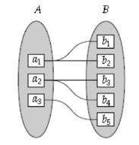
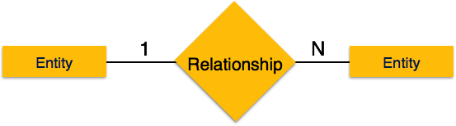
Cardinality of relationships
One-to-many − An entity in A is associated with any number (zero or more) of entities in B while an entity in B can be associated with at most one entity in A. it is denoted as '1:N'.

Slide 34
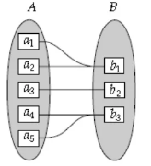
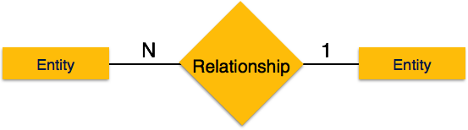
Cardinality of relationships
Many-to-one − An entity in A is associated with at most one entity in B, however, an entity in B can be associated with any number (zero or more) of entities in A. it is denoted as 'N:1'.

Slide 35
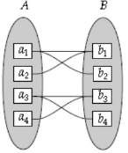
Cardinality of relationships
Many-to-many An entity in A is associated with any number (zero or more) of entities in B and an entity in B can be associated with any number (zero or more) of entities in A. it is denoted as ‘M:N'.

Slide 36
Cardinality of relationships
The relationship type WORKS_ON is of cardinality ratio M:N, because the rule is that an employee can work on several projects and a project can be done by several employees.
Works_on
Employee
N
N
Projects

Slide 37
Strong and Weak entities
An entity should have a key attribute which uniquely identifies each entity in the entity set, but there exists some entity for which key attribute can’t be defined.
The entity sets which do not have sufficient attributes to form a primary key are known as weak entity sets and the entity sets which have a primary key are known as strong entity sets.
As the weak entities do not have any primary key, they cannot be identified on their own, so they depend on some other entity (known as owner entity).
The weak entities have total participation constraint (existence dependency) in its identifying relationship with owner identity.
NB – Weak entity always has total participation but Strong entity may not have total participation.

Slide 38
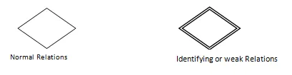
Strong and Weak entities
A relationship with weak entity is shown using double diamond. The weak entity is represented using double rectangles.

Slide 39
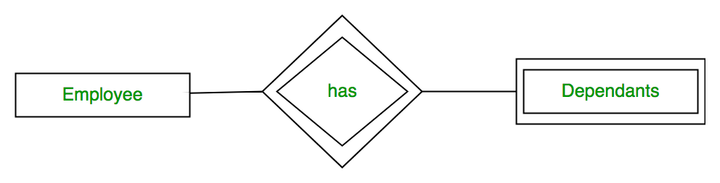
Strong and Weak entities
Example-1:
A company may store the information of dependents (Parents, Children, Spouse) of an Employee. But the dependents don’t have existence without the employee. So Dependent will be weak entity type and Employee will be Identifying Entity type for Dependent.

Slide 40
Weak entities
Example 2
The existence of hotel rooms is entirely dependent on the existence of a hotel. So room can be seen as the weak entity of the hotel.
Example-3:
The bank account of a particular bank has no existence if the bank doesn’t exist anymore.

Slide 41
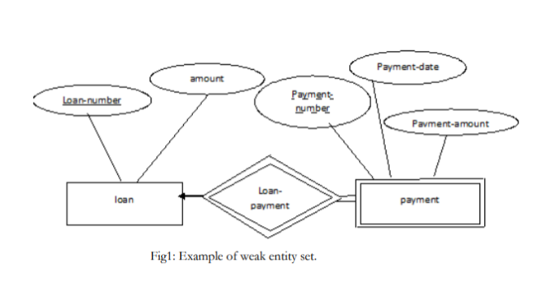
Weak entity example

Slide 42
Advantages of ER Modeling
ER Modeling is simple and easily understandable. It is represented in business users language and it can be understood by non-technical specialist.
Intuitive and helps in Physical Database creation.
Can be generalized and specialized based on needs.
Can help in database design.
Gives a higher level description of the system.

Slide 43
Disadvantages of ER Modeling
Physical design derived from E-R Model may have some amount of ambiguities or inconsistency.
Sometime diagrams may lead to misinterpretations

Slide 44
DESKTOP production industry prides itself on shipping goods from abroad. Shipped items can be characterized by item number (unique), weight, dimensions, insurance amount, destination, and final delivery date. Shipped items are received into the company system at a single retail center. Retail centers are characterized by their type, uniqueID, and address. Shipped items make their way to their destination via one or more standard company transportation events (i.e., flights, truck deliveries). These transportation events are characterized by a unique scheduleNumber, a type (e.g, flight, truck), and a deliveryRoute.

Slide 45
1. Given student, lecturer and department as entities with the following attributes
Student: name, registration number and course
Lecturer: staff_number, phone_number
Department: dept_id, dept_name
The relationship between the entities are as follows
Many students belong to a single department
Several lecturers belong to one department
One lecturer teaches many students
Draw the Entity-Relationship diagram (ER)

Slide 46
2. Company Y deals with writing and publishing articles. An employee of the company is characterized by employeeID (unique), name (first name and last name) and E-mail address. One employee can write several articles which are identified by a uniquesarticle id, title, timestamp and text body. Each article can contain one or more comments from different people. Each comment is identified by its unique ID, timestamp and text. An employee can also post a comment on any published article. Model the above database using an ER model

